Slide 1

ICub Joints Calibration
Summary
What is it?
Calibration types
Joint calibration – how to?

Slide 2
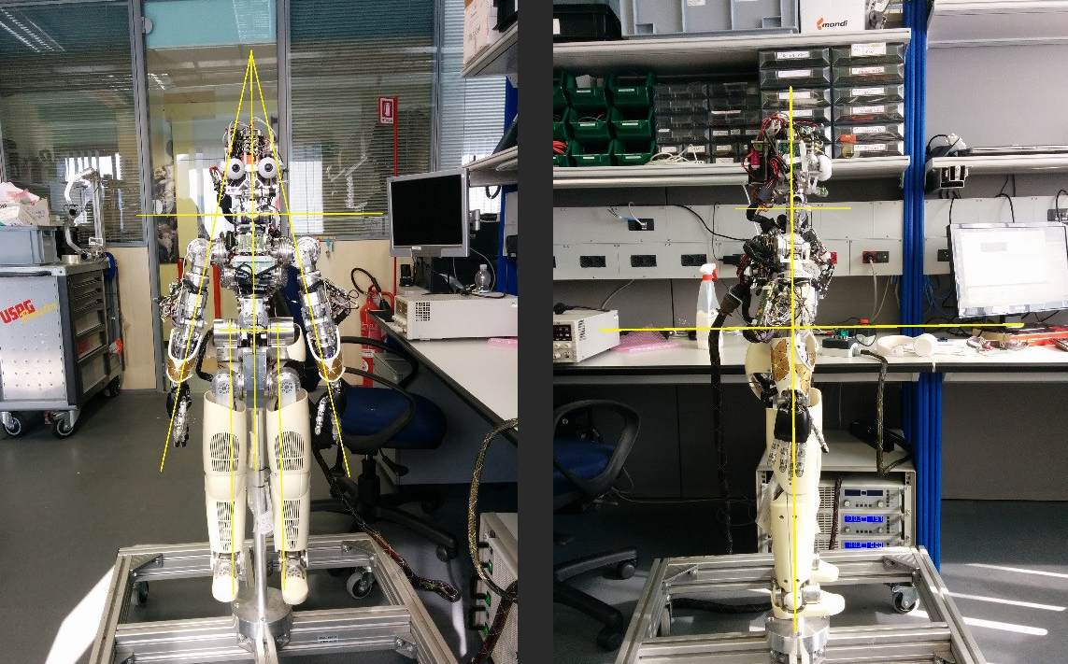
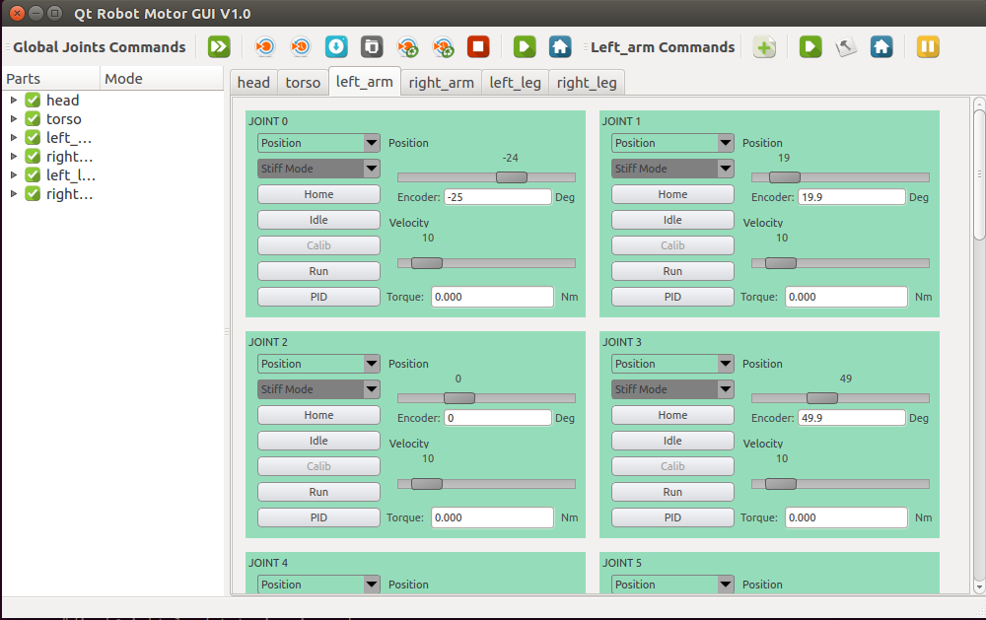
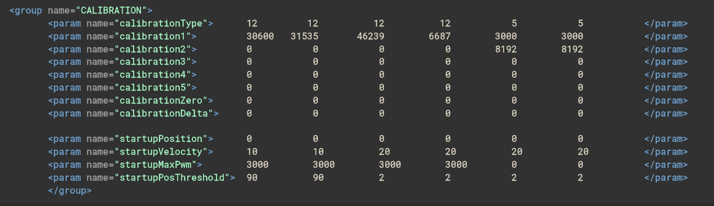
What is it?
The joint calibration is done for each new robot, but you may need to do it after a mechanical intervention on the robot (i.e. Failures, damages)
After that, the robot knows the "zero " position encoders values and can go in the "startup position"
To do that, you basically need to manually put the robot in the zero position , run the robot enabling the "raw data" readings from the yarpmotorgui and put the values in the correspondent XML files.
After that, the robot knows the "zero " position encoders values and can go in the "startup position"
iCub startup
Calibration XML file
iCub "zero" position
yarpmotorgui

Slide 3
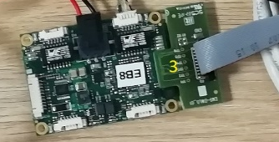
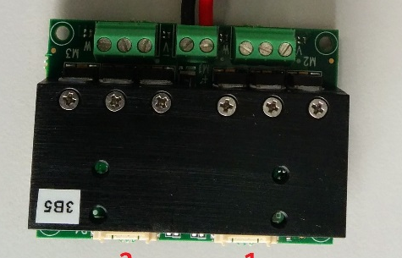
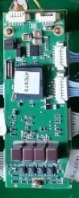
Calibration types
The calibration types on the iCub 2.X:
The calibration types are used at low level by the different control boards (ems4,mc4plus and 2foc) for different joint/motor types. They are four:
type 12: you only need to insert the absolute value of the encoder in the zero position
type 5: no need to insert values, it calibrates automatically (for instance pronosupination of the arm)
type 7: you need to insert two values , Vmax and Vmin (for instance fingers abduction and thumb oppose)
type 6: (fingers) you need to insert two values, Vmax and Vmin, corresponding to fingers closed (ideally 0) and open (ideally 255)
Form more info about calybration types go here
ems4
2foc
mc4plus

Slide 4
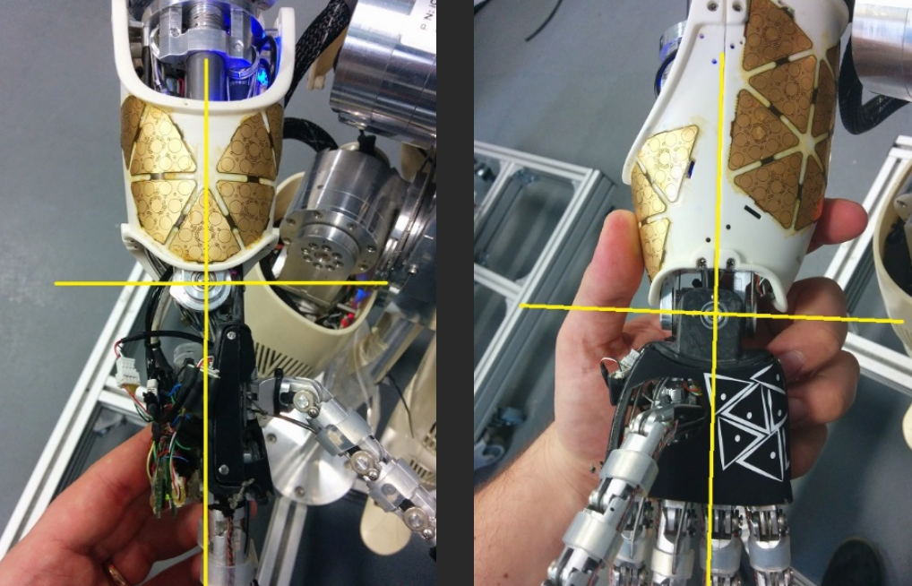
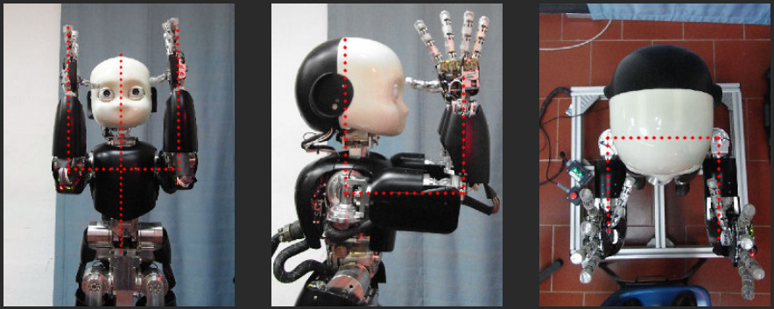
Joint calibration – how to?
The joints calibration consist in :
Put the robot in the zero position
Get absolute encoder raw data for the joint via yarpmotorgui
Put the value in the XML calibration file
Do the arms fine calibration, playing with the Calibration Delta parameter
You can play with the deltas also for the other joints in order of your needs
All the mods on the XML files should be done in a fork of the robots-configuration repo and ,once finished, open a PR VS the original repo. Once the PR is merged, you should update the robotology-superbuild on the icub-head and do a make of the build in order to properly install the new files
Docs resources
Robot Calibration
Calibration types

